Slide 1
Price an Asian option by PDE approach
5/24 2007

Slide 2
PDE & the pricing of an option
The advantages of the PDE approach are that it is generally faster than Monte Carlo methods and that it gives the results for all initial prices (and even for all strikes or all maturities T in some cases).
The drawback is that the numerical methods are usually more complicated to implement for PDE.
-- Francois Dubois
& Tony Lelievre

Slide 3



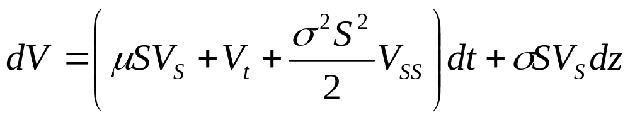
B.S. PDE
Suppose an option has payoff function
the value of the option at time t is
By Black-Scholes assumption,
where dz is a standard Brownian motion.
By Ito lemma,

Slide 4
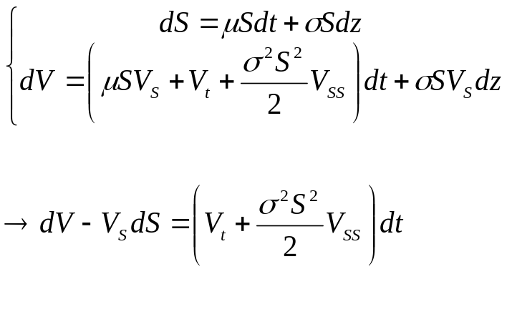

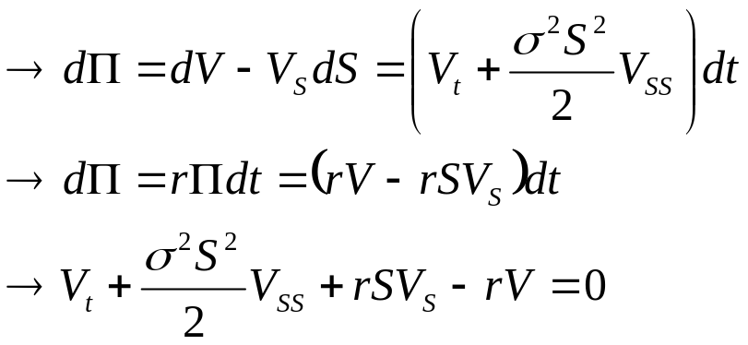
B.S. PDE
Long: 1 share option
Short: Vs share underlying asset
the value of this portfolio
is riskless
This is a PDE for vanilla option

Slide 5


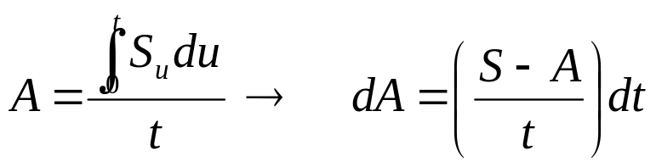
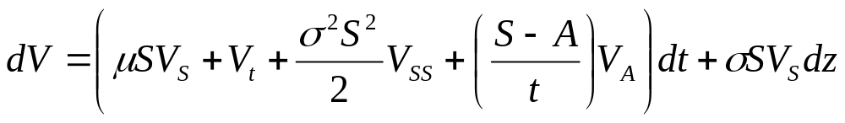
Pricing an Asian option by PDE approach
Suppose an option has payoff function
the value of the option at time t is
where
By Black-Scholes assumption,
where dz is a standard Brownian motion.
By multi-dimension Ito lemma,

Slide 6
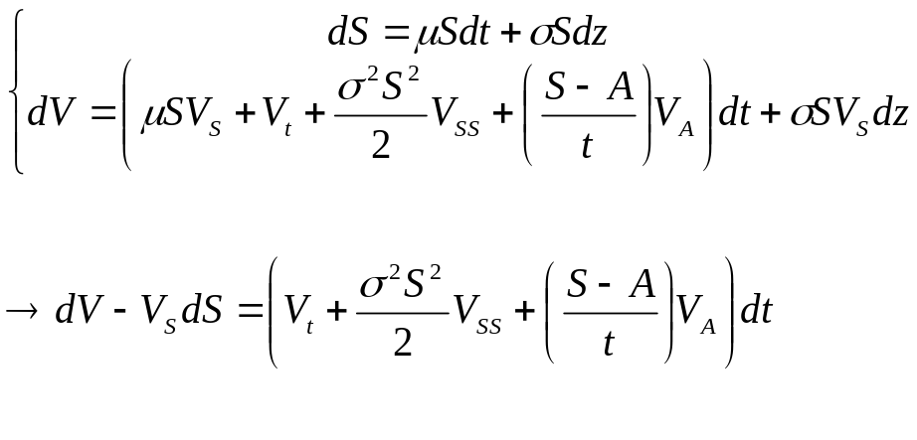
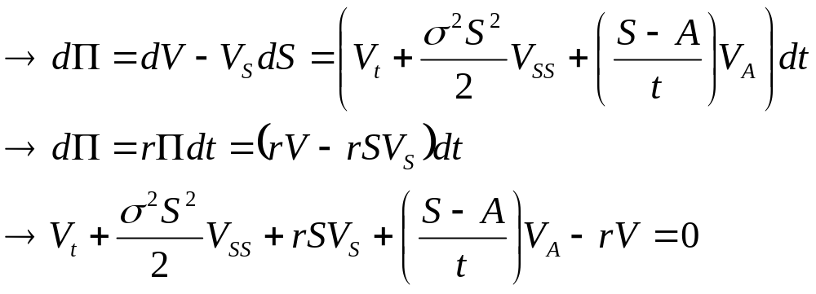
Pricing an Asian option by PDE approach
Long: 1 share Asian option
Short: Vs share underlying asset
the value of this portfolio
is riskless
This is a PDE for Asian option

Slide 7
PDE & the pricing of an option
the PDE approach gives the results for all the time, all initial prices, all running average.

Slide 8
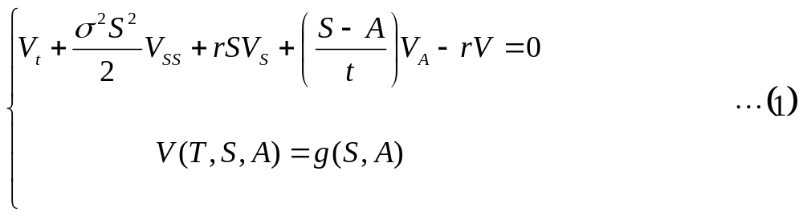

Pricing an Asian option by PDE approach
Solving this PDE using finite difference take time for V is a function with 3 variables.

Slide 9
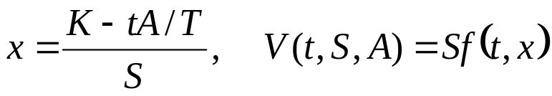
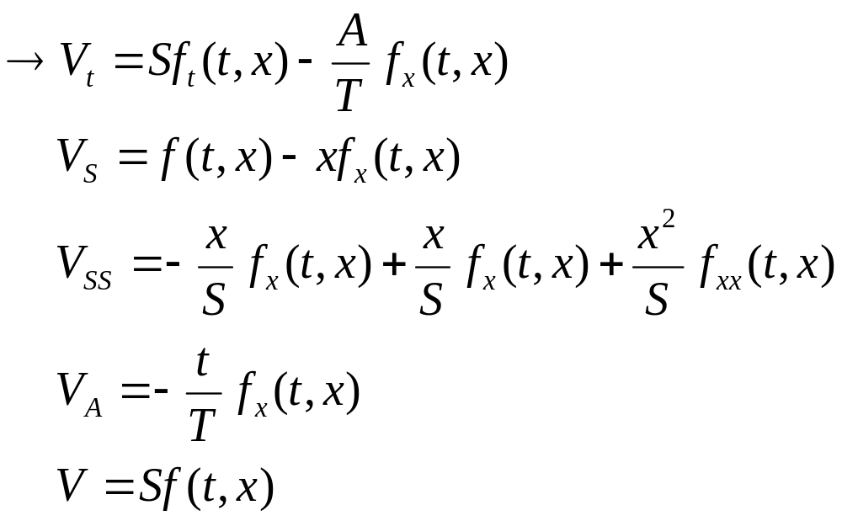
Change of variable
Francois Dubois & Tony Lelievre (2005)
Change of variable

Slide 10

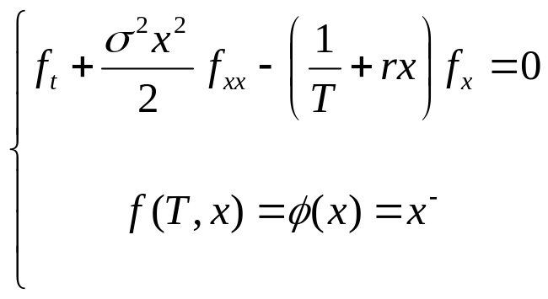


Change of variable
Francois Dubois & Tony Lelievre (2005)
PDE (1) with boundary condition is reduced to:
Solving this PDE by finite difference method take time
Note that this PDE has been obtained by Rogers & Shi (1995) by using some different approach.

Slide 11
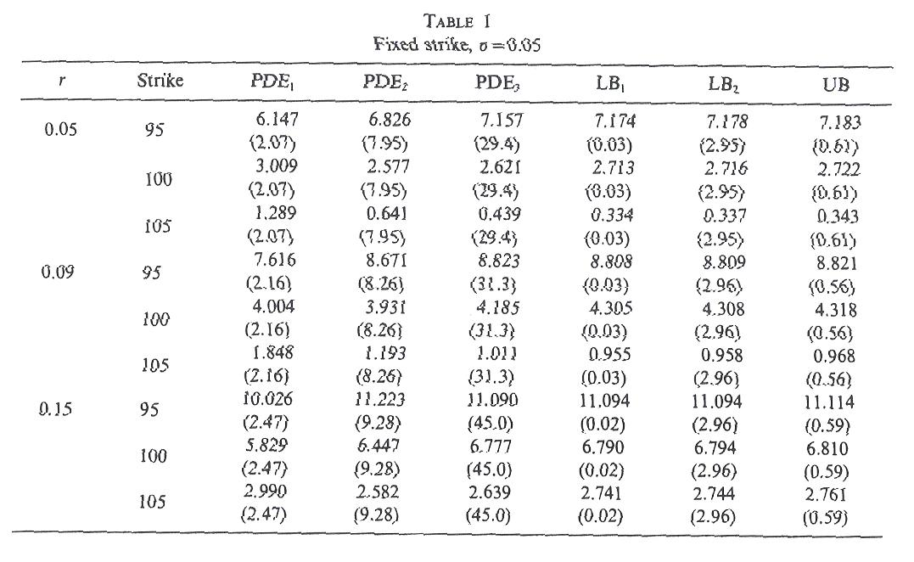
Numerical results for Rogers & Shi PDE

Slide 12
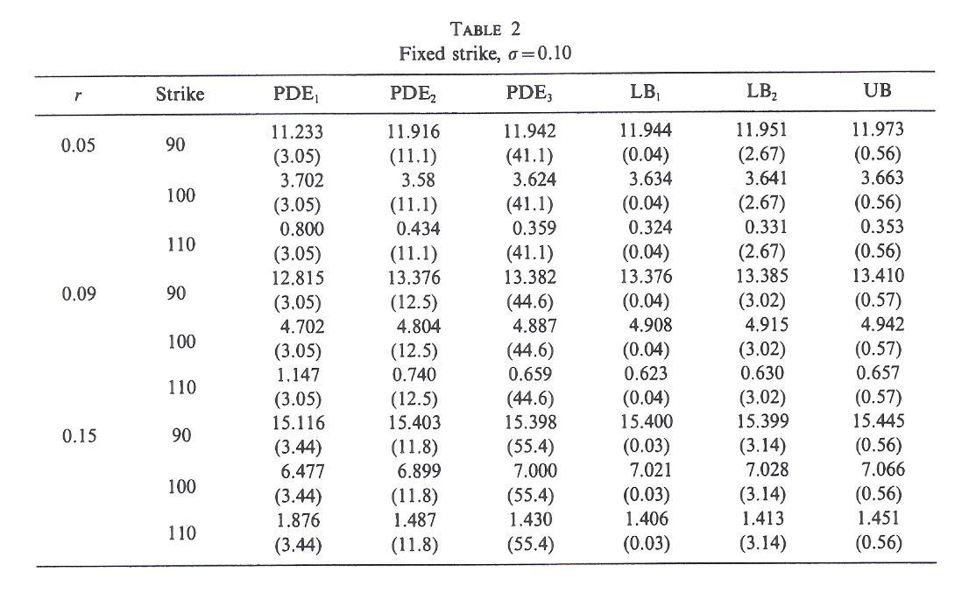
Numerical results for Rogers & Shi PDE

Slide 13
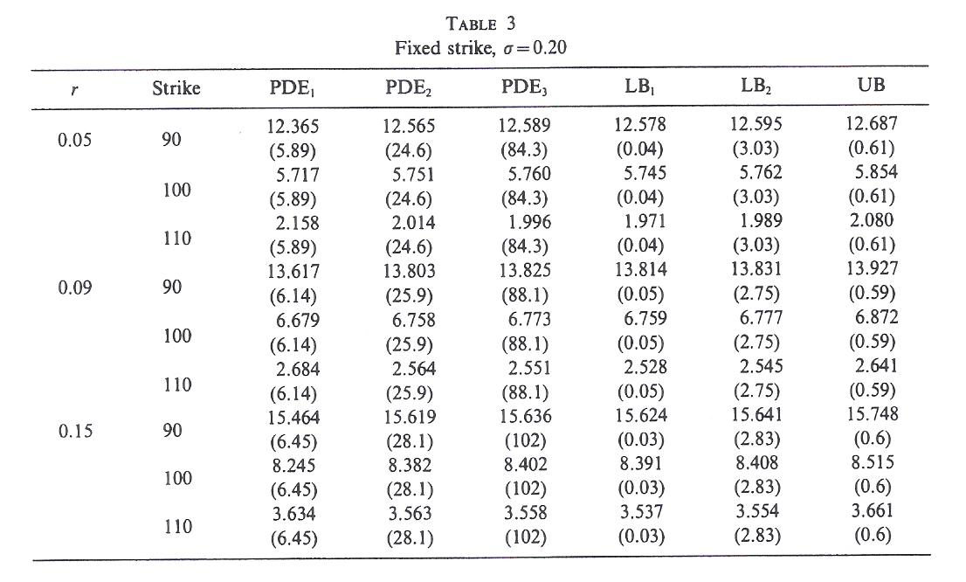
Numerical results for Rogers & Shi PDE

Slide 14
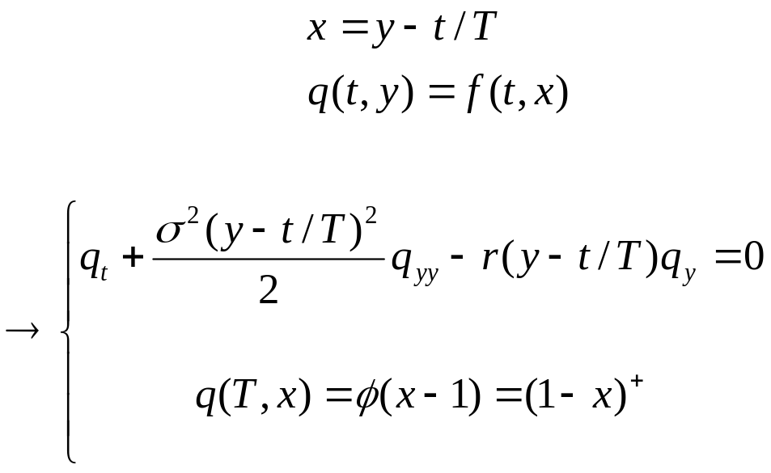
Change of variable
Francois Dubois & Tony Lelievre (2005)
Rogers & Shi’s PDE gives poor results, especially when the volatility is small. These poor results are due to the fact when x is close to zero, the advective term is larger than the diffusion term.
Change of variable
This PDE has been obtained by Vecer (2001) by using some financial arguments

Slide 15
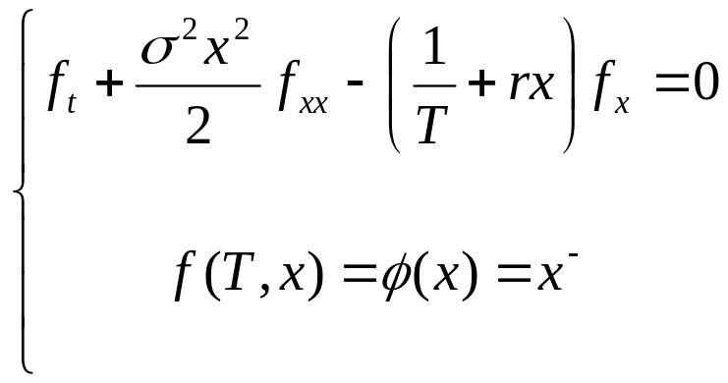
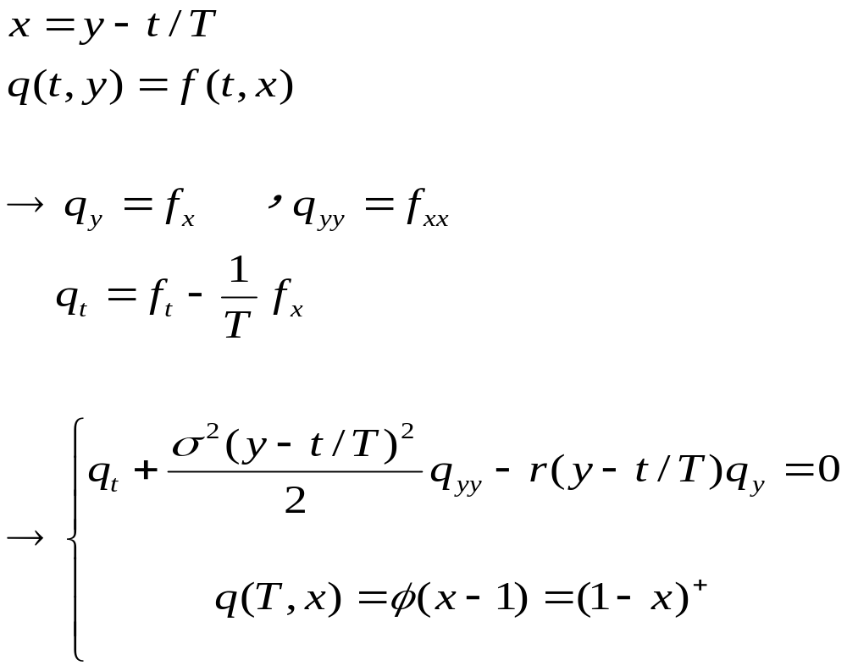
The reason why we chose this change of variable
The PDE (2) :

Slide 16
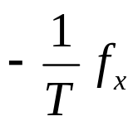
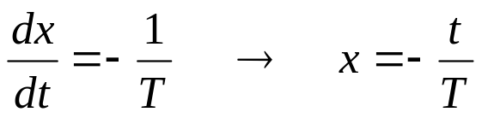
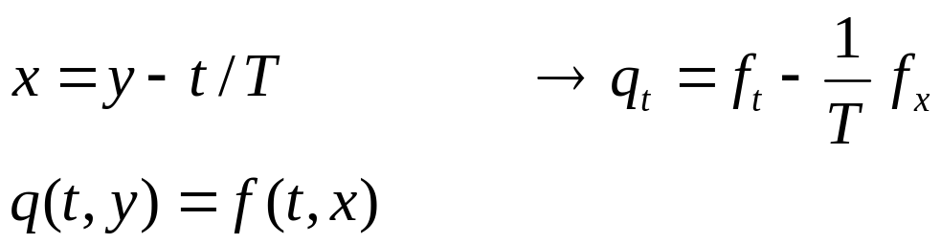
The reason why we chose this change of variable
In order to fit the term
we solve the ODE
So that we chose

Slide 17
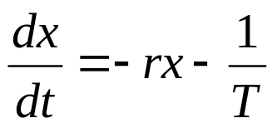
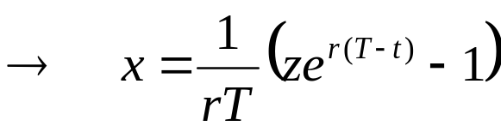
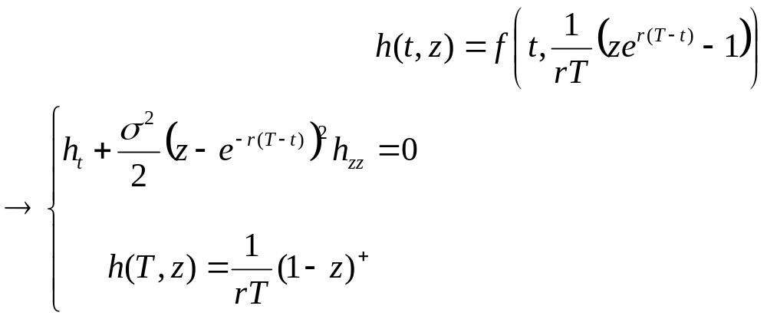
Change of variable
This approach can be generalized. For example, in order to completely get rid of the advective term, we solve the ODE:
Change of variable

